Slide 1
Digital Computer Organization
A full guide through the MCA coarse.
Author-Anushka Mundley
IC-2K18
MCA 3sem

Slide 2
UNIT – 1
Overview
1. What is a computer?
2. Computer Organization & Architecture.
3. Von neuman Architecture
4. Interconnection structures
5. Bus interconnection
(a) System bus (b) Data bus (c) Address bus (d)Control bus

Slide 3
Introduction to Computer Organization
Computer architecture refers to those attributes of a system visible to a programmer or, put another way, those attributes that have a direct impact on the logicalexecution of a program.
Computer organization refers to the operational units and their interconnections that realize the architectural specifications.
Examples of architectural attributes include the instruction set, the number of bits used to represent various data types (e.g., numbers, characters), I/O mechanisms, and techniques for addressing memory.
Organizational attributes include those hardware details transparent to the programmer, such as control signals; interfaces between the computer and peripherals; and the memory technology used.
For example, it is an architectural design issue whether a computer will have a multiply instruction. It is an organizational issue whether that instruction will be implemented by a special multiply unit or by a mechanism that makes repeated use of the add unit of the system

Slide 4
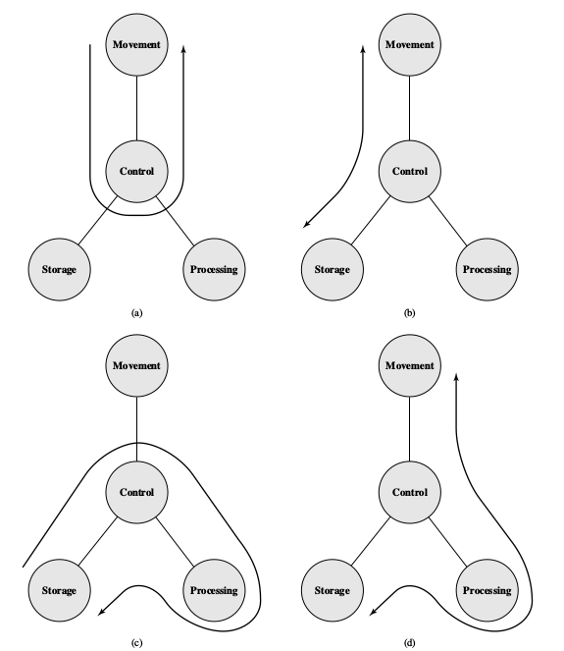
Structure and function
Structure:- The way in which components are interrelated.

Slide 5
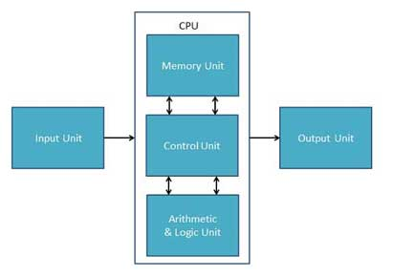
Function:The operation of each indivisual component as a part of structure.

Slide 6
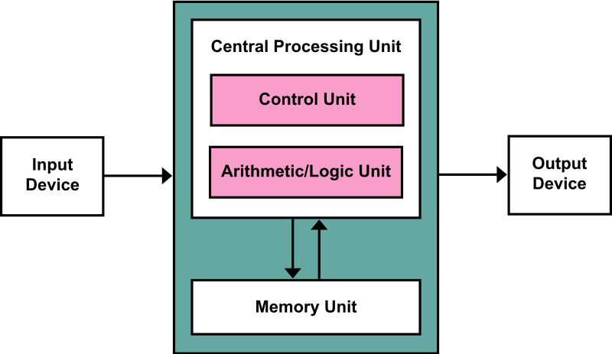
Von-Newman Architecture
In a Von-Neumann architecture, the same memory and bus are used to store both data and instructions that run the program.

Slide 7
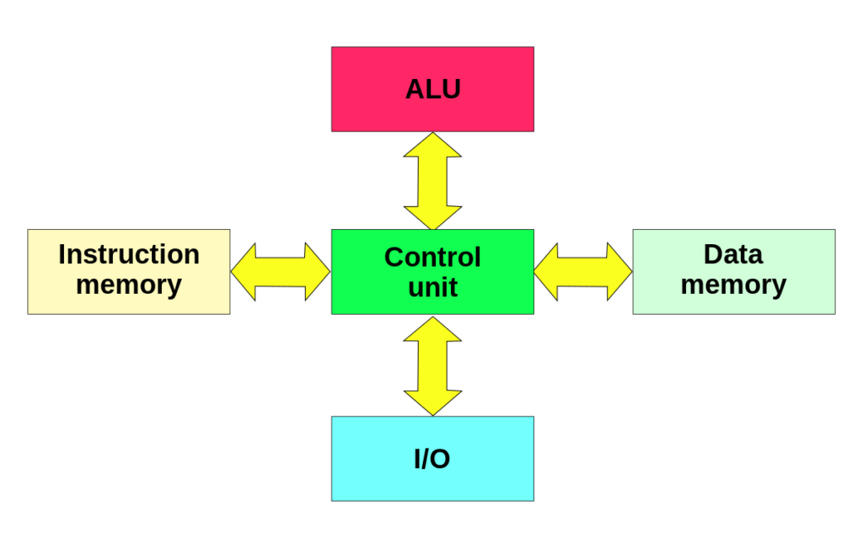
Harvard Architecture The Harvard architecture stores machine instructions and data in separate memory units that are connected by different busses. In this case, there are at least two memory address spaces to work with, so there is a memory register for machine instructions and another memory register for data

Slide 8
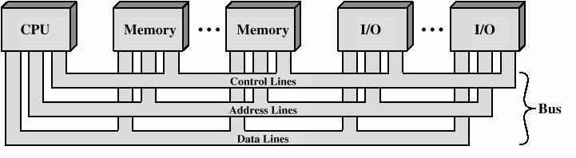
Bus Interconnection
A bus is a communication pathway connecting two or more devices. A key characteristic
of a bus is that it is a shared transmission medium. Multiple devices connect
to the bus, and a signal transmitted by any one device is available for reception by all
other devices attached to the bus.

Slide 9
The data lines provide a path for moving data among system modules. These lines, collectively, are called the data bus.
The address lines are used to designate the source or destination of the data on the data bus.
The control lines are used to control the access to and the use of the data and address lines.

Slide 10
UNIT-2
The major functions or requirements for an I/O module fall into the following
categories:
• Control and timing
• Processor communication
• Device communication
• Data buffering
• Error detection
Input Commands
There are four types of I/O commands that an I/O module may receive when it is addressed by a processor:
• Control: Used to activate a peripheral and tell it what to do.
• Test: Used to test various status conditions associated with an I/O module and its peripherals.
• Read: Causes the I/O module to obtain an item of data from the peripheral
and place it in an internal
• Write: Causes the I/O module to take an item of data (byte or word) from the data bus and subsequently transmit that data item to the peripheral.

Slide 11
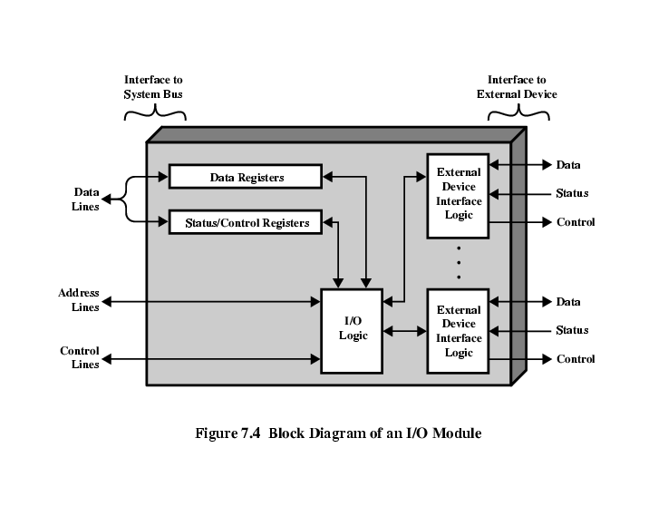

Slide 12
The problem with programmed I/O is that the processor has to wait a long time for the I/O module of concern to be ready for either reception or transmission of data.
An alternative is for the processor to issue an I/O command to a module and then go on to do some other useful work.The I/O module will then interrupt the processor to request service when it is ready to exchange data with the processor.The processor then executes the data transfer, as before, and then resumes its former processing.

Slide 13
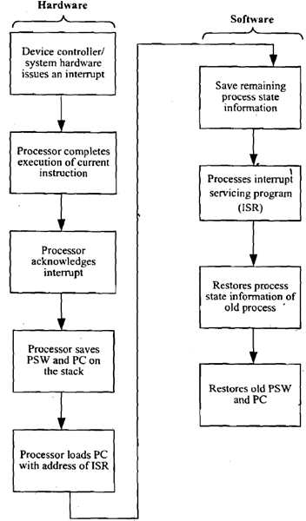
A priority interrupt is a system which decides the priority at which various devices, which generates the interrupt signal at the same time, will be serviced by the CPU. ... When two or more devices interrupt the computer simultaneously, the computer services the device with the higher priority first.

Slide 14
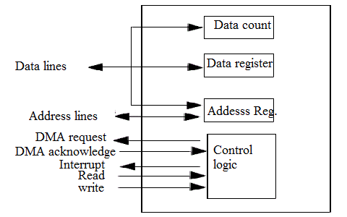
Interrupt-driven I/O, though more efficient than simple programmed I/O, still requires
the active intervention of the processor to transfer data between memory and
an I/O module, and any data transfer must traverse a path through the processor.
Thus, both these forms of I/O suffer from two inherent drawbacks:
1. The I/O transfer rate is limited by the speed with which the processor can test
and service a device.
2. The processor is tied up in managing an I/O transfer; a number of instructions
must be executed for each I/O transfer

Slide 15
The I/O channel represents an extension of the DMA concept. An I/O channel has
the ability to execute I/O instructions, which gives it complete control over I/O
operations. In a computer system with such devices, the CPU does not execute I/O
instructions. Such instructions are stored in main memory to be executed by a
special-purpose processor in the I/O channel itself. Thus, the CPU initiates an I/O
transfer by instructing the I/O channel to execute a program in memory. The program
will specify the device or devices, the area or areas of memory for storage, priority,
and actions to be taken for certain error conditions. The I/O channel follows
these instructions and controls the data transfer.
Two types of I/O channels are common.

Slide 16
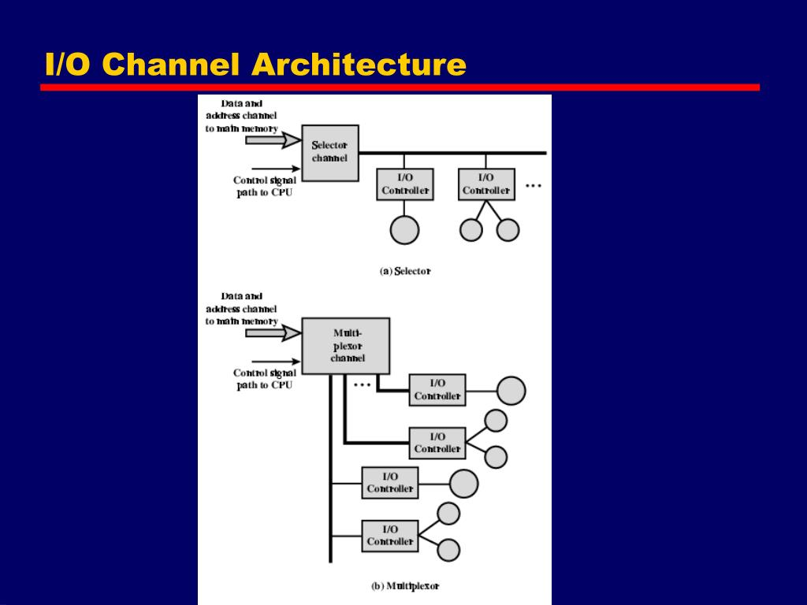

Slide 17
Synchronous vs. Asynchronous
Synchronous data transfer: sender and receiver use the same clock signal
supports high data transfer rate
needs clock signal between the sender and the receiver
requires master/slave configuration
Asynchronous data transfer: sender provides a synchronization signal to the receiver before starting the transfer of each message
does not need clock signal between the sender and the receiver
slower data transfer rate

Slide 18
STROBE CONTROL
In computer or memory technology, a strobe is a signal that is sent that validates data or other signals on adjacent parallel lines. In memory technology, the CAS (column address strobe) and RAS ( row address strobe ) signals are used to tell a dynamic RAM that an address is a column or row address.
HANDSHAKING
handshaking is the exchange of information between two modems and the resulting agreement about which protocol to use that precedes each telephone connection. You can hear the handshaking in those crunching and other sounds when you make a dial-out call from your computer.
Since the modems at each end of the line may have different capabilities, they need to inform each other and settle on the highest transmission speed they can both use. At higher speeds, the modems have to determine the length of line delays so that echo cancellers can be used properly.

Slide 19
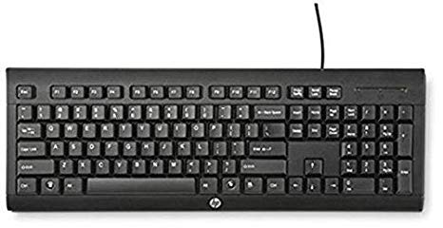
KEYBOARD
When a key is pressed on a keyboard, two small pieces of conductive material are pushed together which cause an electrical signal to be sent to eh computer. The computer recognises which key was pressed by which circuit was completed. The computer then sends this information to the piece of software which is active at the time, for example the Word Processor.

Slide 20

MOUSE
An optical mouse has a small red light at the bottom of it which you will notice if you turn it over. This small red light comes from an LED (light emitting diode). The light is used to recognise small patterns on the surface which the mouse is moving on. The light is sent to a CMOS sensor for analysis. If the mouse is moved, the CMOS sensor (complimentary metal-oxide semiconductor) will recognise this from the change in where the patters are on the surface. It will in turn send this information to the computer which will make the movement of the mouse cursor, or character in a video game.

Slide 21
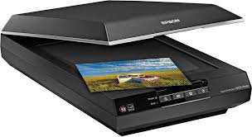
SCANNER
A scanner allows you to take a copy of a physical document and store it in digital form on a computer. A bright light moves across the document. The light is reflected in to a light-sensitive electronic integrated circuit called a CCD (charge coupled device). From here the light is assembled in to digital code which represents which colour of light was in which part of the image. The data is put together to form the digital version of the scanned image.

Slide 22

TOUCHSCREEN
Touchscreen is a general term used to describe any device which uses touch to control the software. There are two main types of touchscreen, resistive and capacitive. Resistive screens have a thin layer over the top of another layer of material. When a certain part of the two layers are pressed together, the screen recognises the position of this contact and sends this information to the software. Capacitive screens are more expensive. They rely on the human body being able to conduct small amounts of electrical current. Touching the screen distorts the electronic field and the device recognises where the interference was.

Slide 23
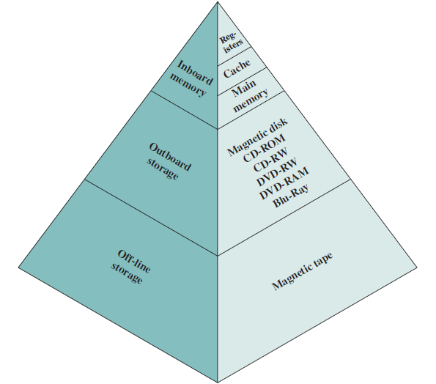
UNIT 3
A variety of technologies are used to implement memory systems, and across this spectrum of technologies, the following relationships hold:
• Faster access time, greater cost per bit
• Greater capacity, smaller cost per bit
• Greater capacity, slower access time

Slide 24
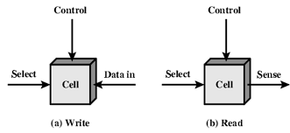
SEMICONDUCTOR MAIN MEMORY
The basic element of a semiconductor memory is the memory cell. Although a variety
of electronic technologies are used, all semiconductor memory cells share certain
properties:
• They exhibit two stable (or semistable) states, which can be used to represent
binary 1 and 0.
• They are capable of being written into (at least once), to set the state.
• They are capable of being read to sense the state.

Slide 25
The distinguishing characteristic of RAM is that it is volatile. A RAM
must be provided with a constant power supply. If the power is interrupted, then the
data are lost.Thus, RAM can be used only as temporary storage.The two traditional
forms of RAM used in computers are DRAM and SRAM.
DYNAMIC RAM RAM technology is divided into two technologies: dynamic and
static. A dynamic RAM (DRAM) is made with cells that store data as charge on
capacitors.The presence or absence of charge in a capacitor is interpreted as a binary
1 or 0. Because capacitors have a natural tendency to discharge, dynamic
RAMs require periodic charge refreshing to maintain data storage. The term
dynamic refers to this tendency of the stored charge to leak away, even with power
continuously applied.

Slide 26
ROM (read only memory)
As the name suggests, a read-only memory (ROM) contains a permanent pattern of data that cannot be changed. A ROM is nonvolatile; that is, no power source is required to maintain the bit values in memory.While it is possible to read a ROM, it is not possible to write new data into it.
A ROM is created like any other integrated circuit chip, with the data actually wired into the chip as part of the fabrication process.This presents two problems:
• The data insertion step includes a relatively large fixed cost, whether oneor
thousands of copies of a particular ROM are fabricated.
• There is no room for error. If one bit is wrong, the whole batch of ROMs must
be thrown out.
PROM
When only a small number of ROMs with a particular memory content is
needed, a less expensive alternative is the programmable ROM (PROM). Like the ROM, the PROM is nonvolatile and may be written into only once. For the PROM, the writing process is performed electrically and may be performed by a supplier or customer at a time later than the original chip fabrication.Special equipment is required for the writing or “programming” process.

Slide 27
EPROM
The optically erasable programmable read-only memory (EPROM) is read
and written electrically, as with PROM. However, before a write operation, all the storage cells must be erased to the same initial state by exposure of the packaged chip to ultraviolet radiation. Erasure is performed by shining an intense ultraviolet light through a window that is designed into the memory chip. This erasure process can be performed repeatedly; each erasure can take as much as 20 minutes to perform. Thus, the EPROM can be altered multiple times and, like the ROM and PROM, holds its data virtually indefinitely.
EEPROM
A more attractive form of read-mostly memory is electrically erasable programmable read-only memory (EEPROM). This is a read-mostly memory that can be written into at any time without erasing prior contents; only the byte or bytes addressed are updated. The write operation takes considerably longer than the read operation, on the order of several hundred microseconds per byte. The EEPROM combines the advantage of nonvolatility with the flexibility of being updatable in
place, using ordinary bus control, address, and data lines. EEPROM is more expensive than EPROM and also is less dense, supporting fewer bits per chip.

Slide 28
Method of Accessing the Memory.
These include the following:
■ Sequential access: Memory is organized into units of data, called records. Access must be made in a specific linear sequence. Stored addressing information is used to separate records and assist in the retrieval process. A shared read– write mechanism is used, and this must be moved from its current location to the desired location, passing and rejecting each intermediate record. Thus, the time to access an arbitrary record is highly variable.
■ Direct access: As with sequential access, direct access involves a shared read– write mechanism. However, individual blocks or records have a unique address based on physical location. Access is accomplished by direct access to reach a general vicinity plus sequential searching, counting, or waiting to reach the final location.

Slide 29
Main memory is the principal internal memory system of the computer. Each location in main memory has a unique address. Main memory is usually extended with a higher- speed, smaller cache. The cache is not usually visible to the programmer or, indeed, to the processor. It is a device for staging the movement of data between main memory and processor registers to improve performance.
The three forms of memory just described are, typically, volatile and employ semiconductor technology.
External, nonvolatile memory is also referred to as secondary memory or auxiliary memory. These are used to store program and data files and are usually visible to the programmer only in terms of files and records, as opposed to individual bytes or words. Disk is also used to provide an extension to main memory known as Virtual Memory.

Slide 30
CACHE MEMORY
Cache memory is designed to combine the memory access time of expensive, high-
speed memory combined with the large memory size of less expensive, lower- speed memory.
The cache contains a copy of portions of main memory. When the processor attempts to read a word of memory, a check is made to determine if the word is in the cache. If so, the word is delivered to the processor. If not, a block of main memory, consisting of some fixed number of words, is read into the cache and then the word is delivered to the processor

Slide 31
CASHE SIZE
The size of the cache should be small enough so that the overall average cost per bit is close to that of main memory alone and large enough so that the overall average access time is close to that of the cache alone.The larger the cache, the larger the number of gates involved in addressing the cache. The result is that large caches tend to be slightly slower than small ones. . The available chip and board area also limits cache size.
MAPPING FUNCTION
Ameans is needed for determining which main memory block currently occupies a cache line. The choice of the mapping function dictates how the cache is organized

Slide 32
DIRECT MAPPING
ASSOCIATIVE MAPPING
SET – ASSOCIATIVE MAPPING
The simplest technique is known as direct mapping, maps each block of main memory into only one possible cache line. The mapping function is easily implemented using the main memory address.
The direct mapping technique is simple and inexpensive to implement. Its main disadvantage is that there is a fixed cache location for any given block. Thus, if a program happens to reference words repeatedly from two different blocks that map into the same line, then the blocks will be continually swapped in the cache, and the hit ratio will be low.
Associative mapping overcomes the disadvantage of direct mapping by permitting each main memory block to be loaded into any line of the cache.
there is flexibility as to which block to replace when a new block is read into the cache.
The principal disadvantage of associative mapping is the complex circuitry required to examine the tags of all cache lines in parallel.
Set- Associative mapping is a compromise that exhibits the strengths of both the direct and associative approaches while reducing their disadvantages.
As with associative mapping, each word maps into multiple cache lines. For set- associative mapping, each word maps into all the cache lines in a specific set, so that main memory block B0 maps into set 0, and so on.

Slide 33
VIRTUAL MEMORY
Computers have a finite amount of RAM, so memory can run out, especially when multiple programs run at the same time. A system using Virtual Memory uses a section of the hard drive to emulate RAM
Virtual memory is a memory management capability of an operating system (OS) that uses hardware and software to allow a computer to compensate for physical memory shortages by temporarily transferring data from random access memory (RAM) to disk storage.
With virtual memory, a system can load larger programs or multiple programs running at the same time, allowing each one to operate as if it has infinite memory and without having to purchase more RAM.
Virtual Address space is increased using active memory in RAM and inactive memory in hard disk drives (HDDs) to form contiguous addresses that hold both the application and its data.

Slide 34
MAGNETIC STORAGE
Magnetic storage or magnetic recording is the storage of data on a magnetized medium. Magnetic storage uses different patterns of magnetisation in a magnetisable material to store data and is a form of non-volatile memory. The information is accessed using one or more read/write heads.
Magnetic storage media, primarily hard disks, are widely used to store computer data as well as audio and video signals. In the field of computing, the term magnetic storage is preferred and in the field of audio and video production, the term magnetic recording is more commonly used. The distinction is less technical and more a matter of preference. Other examples of magnetic storage media include floppy disks, magnetic recording tape, and magnetic stripes on credit cards.

Slide 35
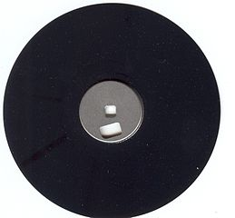
MAGNETIC DISK
A disk is a circular platter constructed of nonmagnetic material, called the Substrate, coated with a magnetizable material. Traditionally, the substrate has been an aluminum or aluminum alloy material.
A magnetic disk is a storage device that uses a magnetization process to write, rewrite and access data. It is covered with a magnetic coating and stores data in the form of tracks, spots and sectors. Hard disks, zip disks and floppy disks are common examples of magnetic disks.
Other examples of magnetic storage media include floppy disks, magnetic recording tape, and magnetic stripes on credit cards..

Slide 36
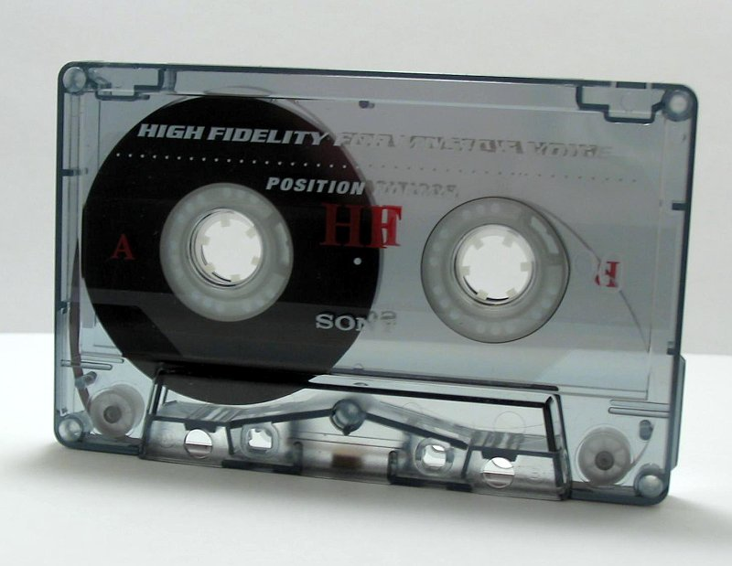
MAGNETIC TAPE
Magnetic tape is a medium for magnetic recording, made of a thin, magnetizable coating on a long, narrow strip of plastic film.
It was developed in Germany in 1928, based on magnetic wire recording. Devices that record and play back audio and video using magnetic tape are tape recorders and video tape recorders respectively.
A device that stores computer data on Magnetic Tape is known as a Tape Drive.
Magnetic tape revolutionized sound recording and reproduction and broadcasting. It allowed radio, which had always been broadcast live, to be recorded for later or repeated airing.

Slide 37
OPTICAL MEMORY
Optical storage is the storage of data on an optically readable medium. Data is recorded by making marks in a pattern that can be read back with the aid of light, usually a beam of laser light precisely focused on a spinning optical disc.
An optical disc drive is a device in a computer that can read CD-ROMs or other optical discs, such as DVDs and Blu-ray discs.
In 1983, one of the most successful consumer products of all time was introduced: the compact disk (CD) digital audio system.
The CD is a non-erasable disk that can store more than 60 minutes of audio information on one side.
The huge commercial success of the CD enabled the development of low- cost optical- disk storage technology that has revolutionized computer data storage.

Slide 38
The different types of optical disk systems are as follows.
CD / CD-R/ CD- RW
Compact Disk. A nonerasable disk that stores digitized audio information. The standard system uses 12-cm disks and can record more than 60 minutes of uninterrupted playing time.
CD Recordable.- Similar to a CD- ROM. The user can write to the disk only once.
CD Rewritable.- Similar to a CD- ROM. The user can erase and rewrite to the disk multiple times.

Slide 39
CD-ROM/DVD-RW/ Blu-ray DVD
CD- ROM Compact Disk Read- Only Memory. A nonerasable disk used for storing computer data. The standard system uses 12-cm disks and can hold more than 650 Mbytes.
DVD Rewritable- The user can erase and rewrite to the disk multiple times. Only one- sided disks can be used.
Blu-ray DVD - High- definition video disk.
DVD / DVD-R
Digital Versatile Disk (DVD) . A technology for producing digitized, compressed representation of video information, as well as large volumes of other digital data. Both 8 and 12 cm diameters are used, with a double- sided capacity of up to 17 Gbytes. The basic DVD is read- only ( DVD- ROM).
DVD Recordable- The user can write to the disk only once. Only one- sided disks can be USED.

Slide 40
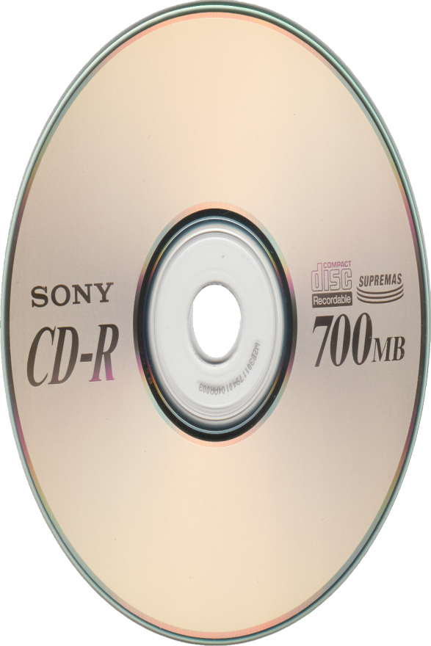
CD-ROM
Both the audio CD and the CD-ROM (compact disk read- only memory) share a similar technology. The main difference is that CD- ROM players are more rugged and have error correction devices to ensure that data are properly transferred from disk to computer.
The disk is formed from a resin, such as polycarbonate. Digitally recorded information is imprinted as a series of microscopic pits on the surface of the polycarbonate. This is done, first of all, with a finely focused, high- intensity laser to create a master disk. The master is used, in turn, to make a die to stamp out copies onto polycarbonate. The pitted surface is then coated with a highly reflective surface, usually aluminum or gold. This shiny surface is protected against dust and scratches by a top coat of clear acrylic. Finally, a label can be silkscreened onto the acrylic.
This Photo by Unknown author is licensed under CC BY-NC.

Slide 41
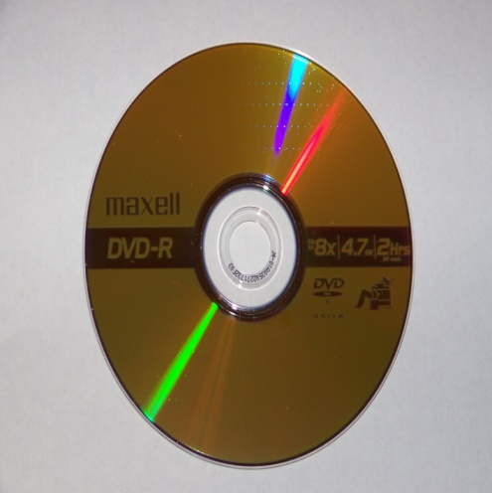
Digital Versatile Disk (DVD)
A technology for producing digitized, compressed representation of video information, as well as large volumes of other digital data. Both 8 and 12 cm diameters are used, with a
double- sided capacity of up to 17 Gbytes. The basic DVD is read- only ( DVD- ROM).
The electronics industry has at last found an acceptable replacement for the analog VHS video tape. The DVD has replaced the videotape used in video cassette recorders (VCRs) and, more important for this discussion, replaced the CD- ROM in personal computers and servers.
The DVD takes video into the digital age. It delivers movies with impressive picture quality, and it can be randomly accessed like audio CDs, which DVD machines can also play.

Slide 42
Three differences b/w CD-ROM & DVD-ROM
1. Bits are packed more closely on a DVD. The spacing between loops of a spiral on a CD is 1.6 mm and the minimum distance between pits along the spiral is 0.834 mm.
2. The DVD employs a second layer of pits and lands on top of the first layer. A
dual- layer DVD has a semireflective layer on top of the reflective layer, and by adjusting focus, the lasers in DVD drives can read each layer separately.
This technique almost doubles the capacity of the disk, to about 8.5 GB. The lower reflectivity of the second layer limits its storage capacity so that a full doubling is not achieved
3. The DVD- ROM can be two sided, whereas data are recorded on only one side of a CD. This brings total capacity up to 17 GB.
As with the CD, DVDs come in writeable as well as read- only versions

Slide 43
UNIT-4
CPU ORGANIZATION

Slide 44
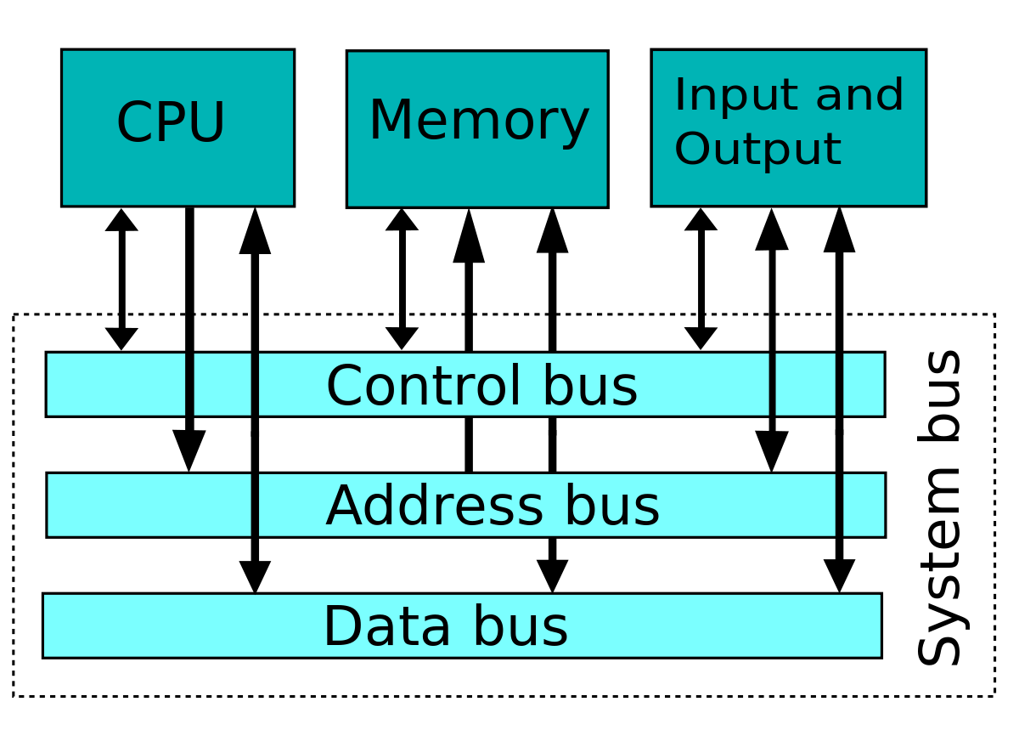
CENTRAL PROCESSING UNIT (CPU)
A central processing unit (CPU) is the electronic circuitry within a computer that carries out the instructions of a computer program by performing the basic arithmetic, logical, control and input/output (I/O) operations specified by the instructions.
Main works done by CPU are -
1. The CPU transfers the instructions and, their input data (Operands) from main memory toregisters in the CPU.
2. The CPU executes the instructions in their stored sequence except when the execution sequence isexplicitly altered by a branch instruction.
3. When necessary, the CPU transfers output data from the CPU registers to main memory.

Slide 45
CPU ORGANIZATION
A stack is a storage device that stores information in a last-in, first-out (LIFO) fashion.
A stack has two operations: push, which places data onto the stack, and pop, which removed data from the stack.
A computer can have a separate memory reserved just for stack operations. However, most utilize main memory for representing stacks.
Hence, all assembly programs should allocate memory for a stack
The set of registers in a computer are connected to the ALU using buses and multiplexers.
The advantages of General register based CPU organization
Efficiency of CPU increases as there are large number of registers are used in this organization.
Less memory space is used to store the program since the instructions are written in compact way.
The disadvantages of General register based CPU organization –
Care should be taken to avoid unnecessary usage of registers. Thus, compilers need to be more intelligent in this aspect.
Since large number of registers are used, thus extra cost is required in this organization.
STACK ORGANIZATION

Slide 46
ACCUMULATOR TYPE ORGANIZATION.
Accumulator is the default address thus after data manipulation the results are stored into the accumulator.
Advantages –
One of the operands is always held by the accumulator register. This results in short instructions and less memory space.
Instruction cycle takes less time because it saves time in instruction fetching from memory.
Disadvantages –
When complex expressions are computed, program size increases due to the usage of many short instructions to execute it. Thus memory size increases.
As the number of instructions increases for a program, the execution time increases.

Slide 47
ADDRESSING MODES
Addressing Modes– The term addressing modes refers to the way in which the operand of an instruction is specified. The addressing mode specifies a rule for interpreting or modifying the address field of the instruction before the operand is actually executed.
The address field or fields in a typical instruction format are relatively small. We would like to be able to reference a large range of locations in main memory or, for some systems, virtual memory.
There are different types of addressing modes as follows - :
1. Immediate addressing
2. Direct addressing
3. Index addressing
4.Register addressing
5.Indexed addressing

Slide 48
ADDRESSING MODES
1) Immediate Mode
2) Direct Mode
Direct Addressing - A very simple form of addressing is direct addressing, in which the address field contains the effective address of the operand: EA = A The technique was common in earlier generations of computers.
The address of the operand is embedded in the instruction code.
Immediate Addressing - The simplest form of addressing is immediate addressing, in which the operand value is present in the instruction Operand = A This mode can be used to define and use constants or set initial values of variables.
The operand is an immediate value is stored explicitly in the instruction.

Slide 49
Indirect Addressing - With direct addressing, the length of the address field is usually less than the word length, thus limiting the address range. One solution is to have the address field refer to the address of a word in memory, which in turn contains a full- length address of the operand. This is known as indirect addressing: EA = (A).
Indirection is noted by placing the name of the register or the memory address given in the instruction in parentheses. The register or memory location that contains the address of the operand is a pointer. When an execution takes place in such mode, instruction may be told to go to a specific address. Once it's there, instead of finding an operand, it finds an address where the operand is located.
Register Addressing - Register addressing is similar to direct addressing. The only difference is that the address field refers to a register rather than a main memory address: EA = R.
The name (the number) of the CPU register is embedded in the instruction. The register contains the value of the operand. The number of bits used to specify the register depends on the total number of registers from the processor set.
3) Indirect Mode
4) Register Mode

Slide 50
INSTRUCTION FORMATS
Instruction format
An instruction is normally made up of a combination of an operation code and some way of specifying an operand, most commonly by its location or address in memory though nonmemory reference instructions can exist.
The operation of the processor is determined by the instructions it executes, referred to as machine instructions or computer instructions. The collection of different instructions that the processor can execute is referred to as the processor’s instruction set.

Slide 51
MACHINE INSTRUCTIONS
A high- level language expresses operations in a concise algebraic form, using variables. A machine language expresses operations in a basic form involving the movement of data to or from registers
A computer should have a set of instructions that allows the user to formulate any data processing task. Another way to view it is to consider the capabilities of a high- level programming language. Any program written in a high- level language must be translated into machine language to be executed. Thus, the set of machine instructions must be sufficient to express any of the instructions from a high- level language. With this in mind we can categorize instruction types as follows:
■ Data processing: Arithmetic and logic instructions.
■ Data storage: Movement of data into or out of register and or memory locations.
■ Data movement: I/O instructions.
■ Control: Test and branch instructions.

Slide 52
ADDRESS INSTRUCTION
3 - ADDRESS INSTRUCTION
2 - ADDRESS INSTRUCTION
1 & 0 - ADDRESS INSTRUCTION
This has three address field to specify a register or a memory location. Program created are much short in size but number of bits per instruction increase. These instructions make creation of program much easier but it does not mean that program will run much faster because now instruction only contain more information but each micro operation (changing content of register, loading address in address bus etc.) will be performed in one cycle only
This is common in commercial computers.Here two address can be specified in the instruction.Unlike earlier in one address instruction the result was stored in accumulator here result cab be stored at different location rather than just accumulator, but require more number of bit to represent address.
One Address Instructions – This use a implied ACCUMULATOR register for data manipulation.One operand is in accumulator and other is in register or memory location.Implied means that the CPU already know that one operand is in accumulator so there is no need to specify it.
A stack based computer do not use address field in instruction.

Slide 53
INSTRUCTION SET SELECTION
The instruction set provides commands to the processor, to tell it what it needs to do. The instruction set consists of addressing modes, instructions, native data types, registers, memory architecture, interrupt, and exception handling, and external I/O.
Examples of instruction set
ADD - Add two numbers together.
COMPARE - Compare numbers.
IN - Input information from a device, e.g., keyboard.
JUMP - Jump to designated RAM address.
JUMP IF - Conditional statement that jumps to a designated RAM address.
LOAD - Load information from RAM to the CPU.
OUT - Output information to device, e.g., monitor.
STORE - Store information to RAM.

Slide 54
Unit - 5 CONTROL UNIT
The control unit performs two basic tasks:
■ Sequencing: The control unit causes the processor to step through a series of micro- operations in the proper sequence, based on the program being executed.
■ Execution: The control unit causes each micro- operation to be performed.
The key to how the control unit operates is the use of control signals.

Slide 55
FETCH CYCLE
Fetch cycle occurs at the beginning of each instruction cycle and causes an instruction to be fetched from memory.
Four registers are involved:
■ Memory address register (MAR): Is connected to the address lines of the system bus. It specifies the address in memory for a read or write operation.
■ Memory buffer register (MBR): Is connected to the data lines of the system bus. It contains the value to be stored in memory or the last value read from memory.
■ Program counter (PC): Holds the address of the next instruction to be fetched.
■ Instruction register (IR): Holds the last instruction fetched.

Slide 56
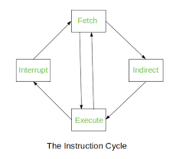
INSTRUCTION CYCLE
A program residing in the memory unit of a computer consists of a sequence of instructions. These instructions are executed by the processor by going through a cycle for each instruction.
In a basic computer, each instruction cycle consists of the following phases:
1 Fetch instruction from memory.
2 Decode the instruction.
3 Read the effective address from memory.
4 Execute the instruction.

Slide 57
THE INDIRECT CYCLE
Once an instruction is fetched, the next step is to fetch source operands. Let us assume a simple one- address instruction format, with direct and indirect addressing allowed. If the instruction specifies an indirect address, then an indirect cycle must precede the execute cycle.
The following micro-operations:
t1: MAR d (IR(Address))
t2: MBR d Memory
t3: IR(Address) d (MBR(Address))
The address field of the instruction is transferred to the MAR. This is then used to fetch the address of the operand. Finally, the address field of the IR is updated from the MBR, so that it now contains a direct rather than an indirect address.

Slide 58
The INTERRUPT CYCLE
At the completion of the execute cycle, a test is made to determine whether any enabled interrupts have occurred. If so, the interrupt cycle occurs. The nature of this cycle varies greatly from one machine to another. A very simple sequence of events, as follows :
t1: MBR d (PC)
t2: MAR d Save_Address PC d Routine_Address
t3: Memory d (MBR)

Slide 59
EXECUTION CYCLE
The fetch, indirect, and interrupt cycles are simple andinvolves a small, fixed sequence of micro-operations and, in each case, the same micro- operations are repeated each time around.
But this is not with execution cycle.
There are a number of different sequences of micro- operations that can occur.
The control unit examines the opcode and generates a sequence of micro- operations based on the value of the opcode. This is referred to as Instruction Decoding
The following sequence of micro-operations occur:
t1: MAR d (IR(address))
t2: MBR d Memory
t3: R1 d (R1) + (MBR)
Firstly, the address portion of the IR is loaded into the MAR. Then the referenced memory location is read. Finally, the contents of R1 and MBR are added by the ALU.

Slide 60
MICRO- PROGRAMMING CONCEPTS
An alternative, which has been used in many CISC processors, is to implement a microprogrammed control unit. It uses micro-programming language.
Each line describes a set of Micro-operations occurring at one time and is known as a Micro-instruction. A sequence of instructions is known as a Microprogram, or Firmware.
This latter term reflects the fact that a microprogram is midway between hardware and software. It is easier to design in firmware than hardware, but it is more difficult to write a firmware program than a software program.

Slide 61
MICRO-PRGRAMMED CONTROL UNIT
The lefthand portion of that register connects to the control lines emanating from the control unit. Thus, reading a microinstruction from the control memory is the same as executing that microinstruction. Sequencing unit loads the control address register and issues a read command

